Slide 1
Lesson 10 Final Project
Cigarette Data
install.packages("Ecdat")

Slide 2
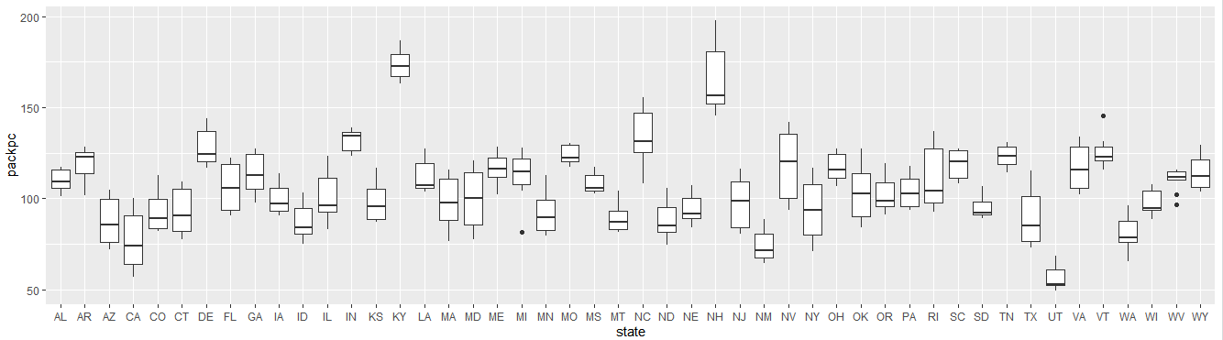
ggplot(Cigarette,aes(x= state, y=packpc)) + geom_boxplot()

Slide 3


Which states have the highest number of packs? Which have the lowest?
The states with the highest number of packs are: KY, NH, NC and IN.
The States with the lowest number of packs are: UT, NM, CA, and WA.

Slide 4
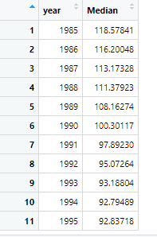
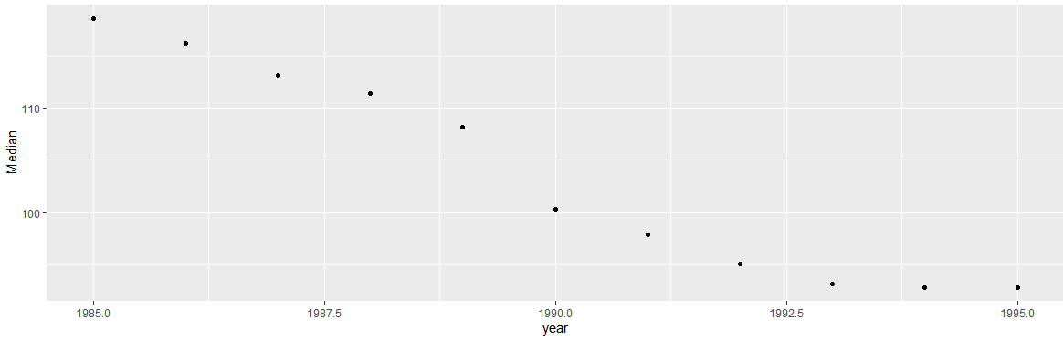
Median over all the states of the number of packs per capita for each year. from 1985 to 1995
Smocking drastically decreased from 1985 to 1995. More than likely because of health initiatives, that educated people on the effects of smoking.

Slide 5
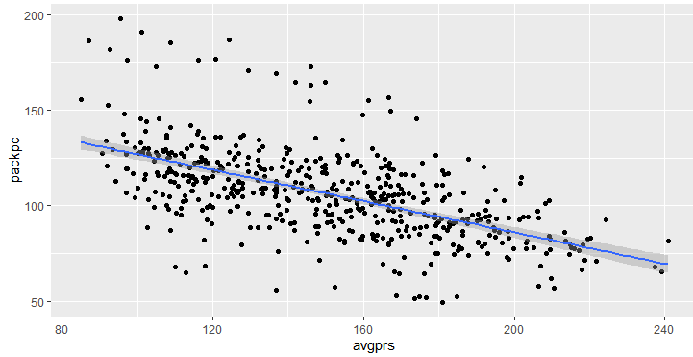
Create a scatter plot of price per pack vs number of packs per capita for all states and years.

Slide 6
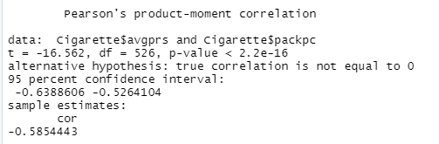
Are the price and the per capita packs positively correlated, negatively correlated, or uncorrelated?
The price and the per capita packs are negatively correlated.

Slide 7
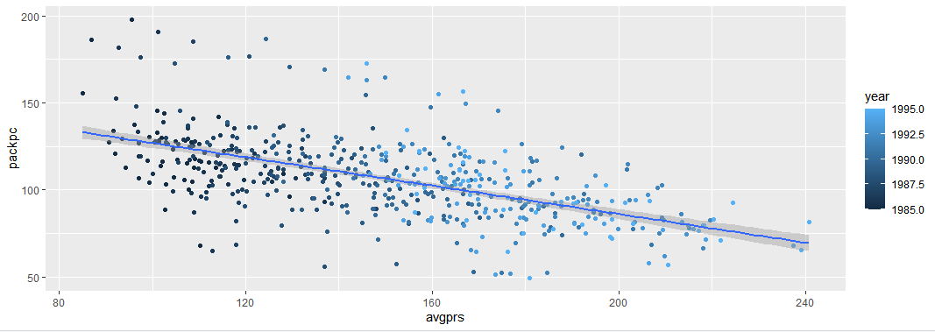
Change your scatter plot to show the points for each year in a different color. Does the relationship between the two variable change over time?

Slide 8
Does the relationship between the two variable change over time?
Yes the relationship between the two changed over time. In 1995 a lot more people were buying cigarettes at a much lower price, compared to 1995. In 1995 not only were prices higher, packs per capita were lower.

Slide 9
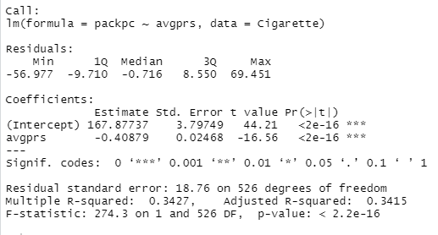
Do a linear regression for these two variables

Slide 10
How much variability does the line explain?
34% of the variability

Slide 11
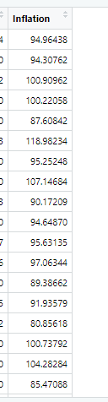
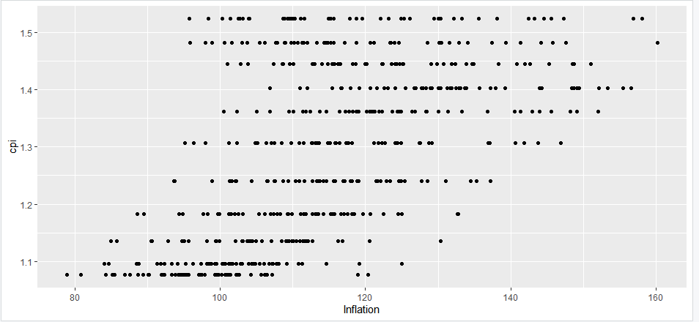
The plot above does not adjust for inflation. You can adjust the price of a pack of cigarettes for inflation by dividing the avgprs variable by the cpi variable. Create an adjusted price for each row, then re-do your scatter plot and linear regression using this adjusted price.

Slide 12
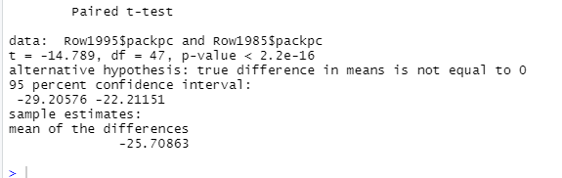
get a vector of the number of packs per capita. Use a paired t-test to see if the number of packs per capita in 1995 was significantly different than the number of packs per capita in 1985.
No there was not a major difference.

